Slide 1
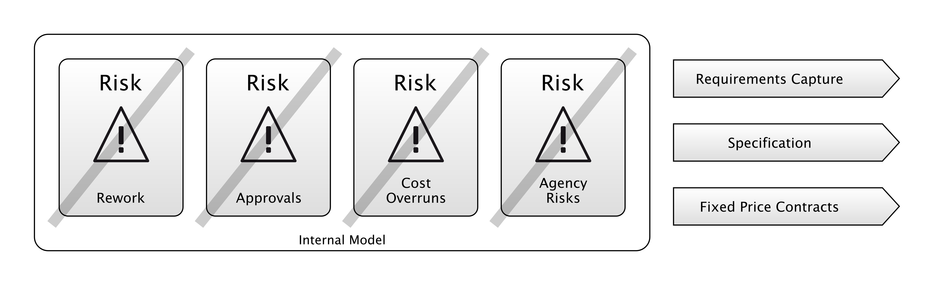
WATERFALL
Notes:
So let's look again at Waterfall. As I said earlier, a lot of the “Financial Crisis era” regulation projects, we got through them with something like this:
Requirements Capture
Specification
Up-Front Plans and Budgets
Why these practices?
Because Waterfall methodologies are borrowed from the construction industry, they manage the risks that you would care about in a construction project, specifically, minimising the risk of rework, and the risk of costs spiralling during the physical phase of the project.
For example, pouring concrete is significantly easier than digging it out again after it sets.
Construction projects are often done by tender which means that the supplier will bid for the job of completing the project, and deliver it to a fixed price.
This is a risk-management strategy for the client: they are transferring the risk of construction difficulties to the supplier, and avoiding the Agency Risk that the supplier will “pad” the project and take longer to implement it than necessary, charging them more in the process.
In order for this to work, both sides need to have a fairly close understanding of what will be delivered, and this is why a specification is created.
In this diagram, the risks on the left are addressed by the actions on the right: requirements capture, specification, fixed price contracts. That’s why they have a bar through them.
Those actions are doing something to address those risks.

Slide 2
WATERFALL
“1. Clients may not know exactly what their requirements are before they see working software and so change their requirements, leading to redesign, redevelopment, and re-testing, and increased costs.”
“2. Designers may not be aware of future difficulties when designing a new software product or feature. “
- Waterfall Model, Wikipedia
Notes:
But, a lot of the time, waterfall was addressing the wrong risks.

Slide 3
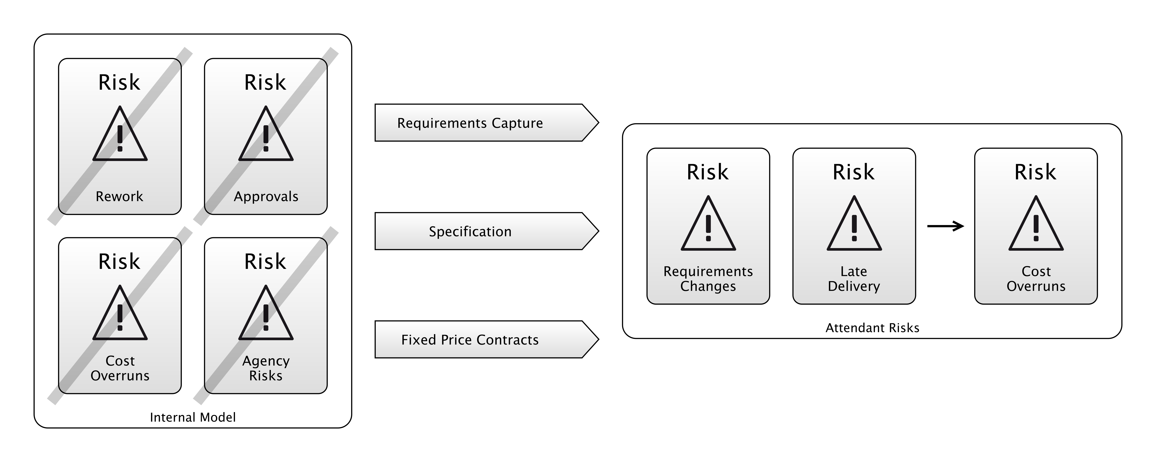
WATERFALL
Notes:
So, here we have the full equation. By taking these actions in the middle, we address the risks on the left.
But… we end up with the risks on the right.
We have the risk that the requirements change, or that the project takes longer than expected.
For big government IT projects, done to tender, this usually meant that the government ended up bailing out the supplier, and shouldering the extra expense.
So as you can see, some of the risks on the left are the same as the ones on the right: the actions taken to manage them made no difference (or made things worse).
The inability to manage these risks led to the identification of a “Software Crisis”, in the 1970’s.
This is how we end up with Agile.
Scrum is probably the most popular Agile methodology, so let’s have a quick look at how that works for a second.

Slide 4
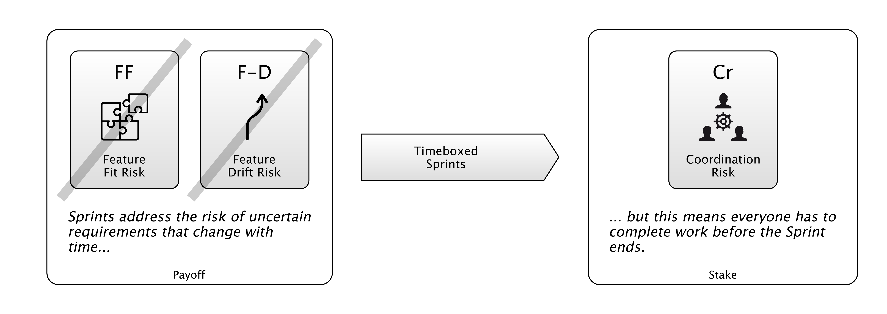
SCRUM
Notes:
So one of the key features - maybe the key feature - of Scrum is that you work in Sprints.
These are like little 2 or 3-week windows of time, where you deliver something to production.
You can see that practice in the middle there. The reason Scrum recommends this is to address those risks on the left:
- The Risk that you don’t build what the customers want the first time,
- and the risk that what the customers want changes while the project is in progress.
But in order to do a Sprint, everyone needs to be given just enough work to do to fill that time, otherwise they’re going to blow out of the end of the Sprint, or be sitting around with nothing to do.
(Well, there’s always something to do, but…)

Slide 5
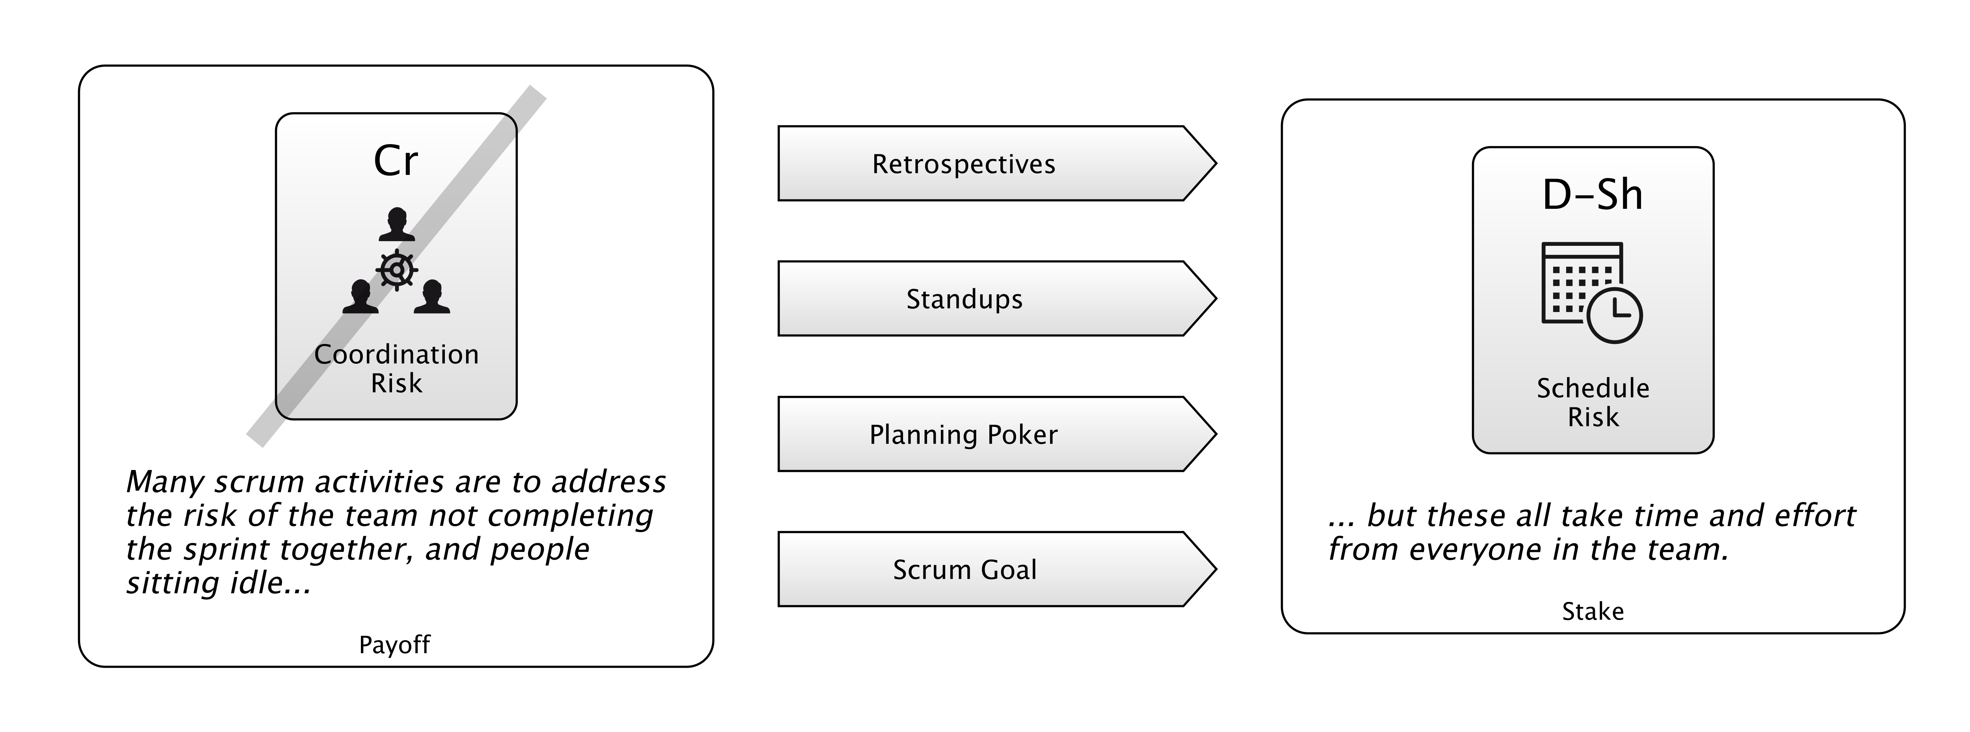
SCRUM
Notes:
So, that Coordination Risk is the major problem with doing Sprints.
How do we address that Risk?
Well, Scrum recommends a bunch more practices to fix that.
Like Retrospectives, where you try and learn what went wrong in the previous sprint.
Daily standup meetings, where you keep track of where everyone is, and check they’re all going to arrive on time.
Planning Poker: this is a kind of estimating game which is done to figure out how much work is going to be put in the Sprint
And a Scrum goal, where everyone commits to achieving some kind of goal with the Sprint, and working towards that.
Having a goal is a great way of Coordinating people so they don’t accidentally work antagonistically, with one person doing something that undoes what another is doing.
But obviously, all that stuff takes time and effort, which may be better spent elsewhere.
If you didn’t have that Coordination Risk problem, you might not have to do some of this other stuff.
And the Coordination Risk problem is there because you’re doing Sprints.

Slide 6
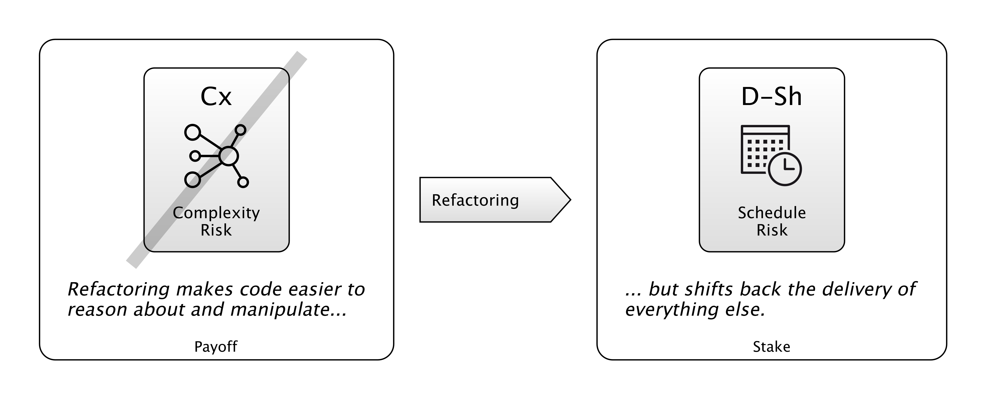
REFACTORING
Notes:
Another Agile Practice then: Refactoring.
What is the value of it? Refactoring is addressing Complexity Risk in your code-base.
That is, the weight of complexity in the codebase, and its resistance to change and comprehension.
Projects can sometimes drown in their own complexity “big balls of mud”. So this is a Risk.
And Technical Debt is an unnecessary excess of this. A lot of the Complexity Risk is risk you’ve taken on because you want to deliver functionality to people, quickly. But sometimes, it accrues accidentally, or because you take short-cuts.
Ideas gets removed, but the code stays complicated. That’s Technical Debt.
So, you refactor.
But that can take time and sometimes it doesn’t work out.
So like the game of Roulette, I’ve labelled these parts of the diagram as the “Payoff” and the “Stake”: it’s like a bet.
You’re betting that you can move to this new place on the Risk Landscape where there is less Complexity Risk.
But sometimes, that place isn’t better. We’re not all-seeing oracles. Our Internal Models are limited.
Sometimes, your refactor doesn’t work out and your amazing simplifying assumption doesn’t pay off.
Let’s look one last one.

Slide 7
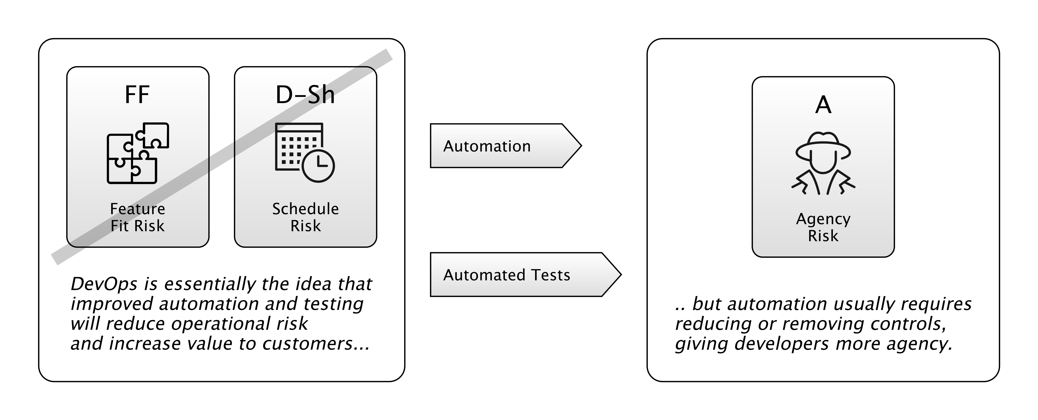
DEVOPS
Notes:
How should we look at DevOps?
The promise of devops is that we can apply automation of processes, and automated testing, to reduce schedule risk and deliver value faster.
On the one hand, this feels quite agile-y, but it’s taken a lot less time to come about. So, in a way, it feels like banks are learning faster than they were before… we’ve gone from 15-20 years for an agile revolution to about 3 or 4 years for devops revolution.
This is a massive improvement!
However, it also feels like a way to “strip back” a lot of those Operational Risk controls that were mandated by Basel 2 and later regulations.
Because automation means sacrificing human oversight: we’re going to end up with more agency risk as a result. That is: the chance that people maliciously or accidentally do things in production we don’t want them to.
I have a colleague at Morgan Stanley who basically believes that DevOps is illegal for banks, that Development and Operations should not be joined because it breaks regulations.
It’s like the see-saw went too far in the direction of locking down production environments, and has now had to go back the other way.
There is obviously no “right answer” to this… we might see this pendulum swing back and forth a bit more.

Slide 8
Notes:
So, we’ve basically been looking at JUnit, DevOps, Waterfall, and Scrum from the perspective of what risks they manage.
And, as we saw, this was something Kent Beck was on about a lot.
But it’s easy to lose sight of this as the underlying physics while you are working in an agile team, and just focus on doing the agile.
That is - applying agile practices in places where they aren’t really relevant.
We have to make sure we use the right tools for the job.

Slide 9
DIFFERENT PRACTICES FOR DIFFERENT RISKS
Notes:
—Different Practices are useful for dealing with different risks.
So, both Waterfall and Scrum have different practices, and those practices address different risks… and also lead to new risks.
Hopefully, the new risks are more palatable than the old ones. If this doesn’t materialise, then we feel the methodology is failing us.
So the practices need to fit the risks.
It feels like this happens a lot in life already.
I can buy Car Insurance, to cover risks related to my car.
Or Travel Insurance, for risks I face going abroad.
I don’t want my house built in an Agile way. I want someone to design it up-front, and give me a quote, and show me what it will look like.
A friend I know went on an agile course last year, and during it, they asked him and his team on the day to build a lego house in an Agile way. He was massively enthusiastic about this task. “The requirements changed so we added an extra bit and some new windows, and then they asked for a bit for the dog…” and so on.

Slide 10
Notes:
I found this image online of some people doing the same thing. If anything this woman’s house is better than his.
But honestly, I don’t think this is a great advertisement for Agile techniques. It’s totally the wrong domain.
Agile techniques are appropriate for managing certain risks.

